Slide 1





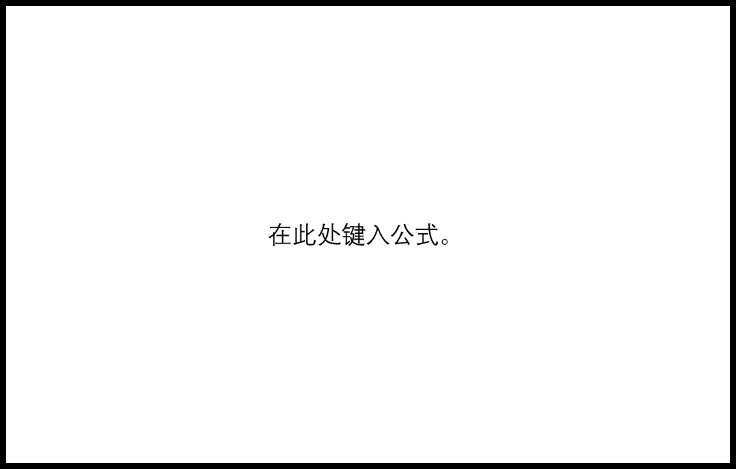




Reward
RL framework
Inference
Past configurations
$$c_{1}$$
$$c_{2}$$
$$c_{3}$$
Configuration 1
Spatial features
Configuration 2
$$e_{1}$$
$$e_{2}$$
$$e_{3}$$
State
.
.
.
Temporal features
Configuration 48
$$e_{2}−e_{1}$$
$$e_{3}−e_{1}$$
RL Agent
train
write
Memory buffer
Training controller
read

